Slide 1

CISC 250 – Business Telecomm Networks
Wireless LAN

Slide 2
Today’s Outline
WLAN Basics
Elements
Configuration
Media Access Control
Different Types of 802.11
a, b, g, n, ac

Slide 3

Wireless LANs – 802.11/Wi-Fi
Shared medium - radio instead of wire
IEEE 802.11 Standard
Basic Service Set (cell)
Set of stations (STA) using same MAC protocol (CSMA/CA for 802.11)
Competing to access shared medium
May be isolated
May connect to backbone via access point (bridge)

Slide 4
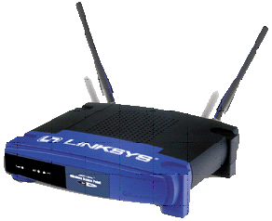
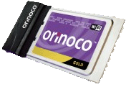
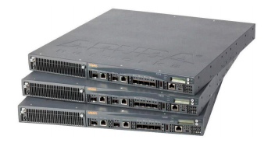
Elements of A Wireless LAN
Access Point (AP)
a wireless LAN transceiver or “base station” that can connect one or many wireless devices simultaneously
~2500 on the UDel campus
Cards – wireless NIC
They accept the wireless signal and relay information. They can be internal and external. (e.g. PCMCIA Card for Laptop and PCI Card for Desktop PC)
Controller
A centralized device (or devices) that coordinate configuration and management of large-scale wireless networks.
UDel has a total of six controllers

Slide 5
Wireless LAN Configurations
Peer-to-peer Workgroup
Also known as Ad Hoc Network
Many wifi printers use this
Infrastructure or Client/Server Network
UDel
UDel Secure
UDel Help

Slide 6
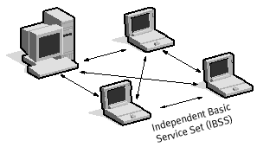
Ad Hoc Mode
There is no access point
Client computers communicate directly with each other
All client computers must be within range of each other
File & printer sharing using a peer-to-peer operating system

Slide 7
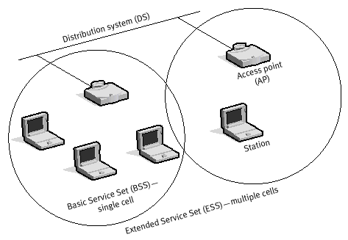
Infrastructure Mode
BSSID = MAC address of the AP
ESSID = The network name (SSID)
Standalone LAN or integrated into an existing enterprise network
Simple, cheap ways to boost your WiFi signal
Cantenna: http://www.youtube.com/watch?v=NVjN9EK7B0E
Parabolic Cookware WiFi Antenna: http://www.youtube.com/watch?v=ozOMtqPOESo

Slide 8
Typical 802.11 Wireless LAN Operation with Access Points
The Wireless Station sends an 802.11 frame to a server via the access point.
The access point is a bridge that converts the 802.11 frame into an 802.3 Ethernet frame and sends the frame to the server.
802.11
Frame
802.3
Frame
Mobile
Station (STA)
Access
Point
Ethernet
Switch (Local LAN)
Server

Slide 9

Large-Scale WLAN Operation with Controllers
Client traffic sent to AP
AP encapsulates traffic and sends to controller via UDel network
Controller decapsulates and strips off 802.11 headers and converts to 802.3
Data then flows to original destination
Controllers keep track of all clients on the UDel network.
Policy Enforcement
Data Usage
QoS markings
Blacklisting
802.11
Frame
GRE
Encapsulated 802.11
Frame
802.3
Frame
Aruba Controller
Aruba Access
Point
UDEL, UDEL Secure
Ethernet
Switch (Local LAN)
Mobile
Station (STA)
Server

Slide 10
802.11 Broadcast Operation
The Wireless Stations and Access Points Broadcast their Signals.
Only one access point or wireless station may transmit at any moment or signals will become scrambled.
Wireless
Station
Collision
About to
Occur
Access
Point
(Beacons -
10 beacons/sec)
Wireless
Station (Probes)

Slide 11
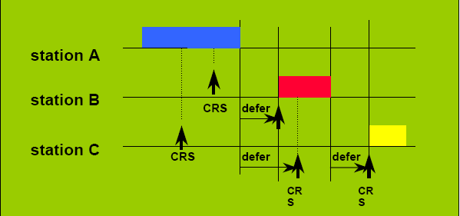
802.11 Media Access Control
CSMA/CA (Carrier Sense Multiple Access with Collision Avoidance) + ACK
Wireless LAN adaptors cannot detect collisions
Carrier Sense – Listen to the media to see if it is free
Collision Avoidance – Minimize chances of collision by starting a random back off timer, when medium is free and prior to transmission

Slide 12
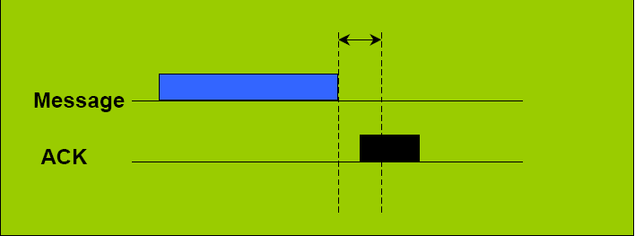
802.11 Media Access Control
Collisions still occur (interference, incapability to sense other carrier end)
Defines a “low level” ACK protocol
Receiver immediately sends back an ACK
If sender does not receive the ACK, retransmits using CSMA/CA
http://www.youtube.com/watch?v=RKkxKG5usaw

Slide 13
Different Types of 802.11
802.11b
Appeared in late 1999
Operates at 2.4GHz radio spectrum (2412 – 2484 MHz)
11 Mbps (theoretical speed)
4-6 Mbps (actual speed)
100 -150 feet range
Interference from mobile phones and Bluetooth devices which can reduce the transmission speed
802.11a
Introduced in 2001
Operates at 5 GHz radio spectrum (5180 – 5825 MHz)
54 Mbps (theoretical speed)
15-20 Mbps (Actual speed)
50-75 feet range
More expensive
Not compatible with 802.11b

Slide 14
Different Types of 802.11
802.11g
Introduced in 2003
Operates at 2.4 GHz radio spectrum
54 Mbps (theoretical speed)
Actual speed varies with different modes
G only
Mixed b and g
Combine the features of both standards (a, b)
100-150 feet range
Compatible with ‘b’

Slide 15
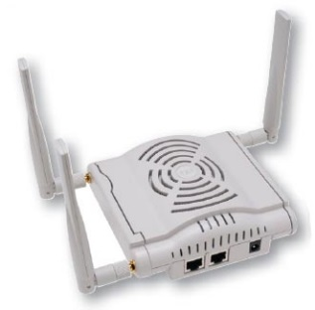
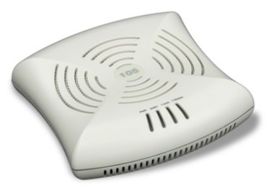
Different Types of 802.11
802.11n
Ratified in September 2009
Draft 2.0 approved 2007
Operates at 2.4/5 GHz radio spectrum
Up to 600 Mbps (theoretical speed)
Typically around 100 Mbps
~300 feet range
Compatible with ‘a/b/g’
2.4 GHz: compatible with b/g
5 GHz: compatible with a
2.4/5 GHz: compatible with a/b/g
Aruba AP 124/5 and AP105s are 802.11a/b/g/n

Slide 16
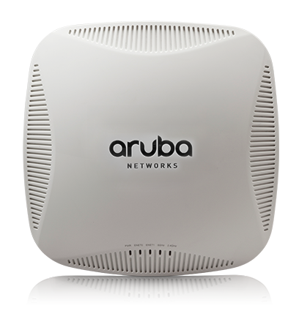
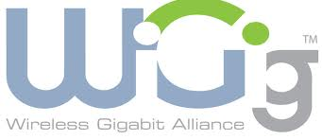
Different Types of 802.11
802.11ac
Ratified January 2014
Operates at 5 GHz radio spectrum only
At least 1 Gbps
Aruba AP220 series APs are 802.11a/b/g/n/ac
East Campus Housing and ISEB are 100% 802.11AC. New UDel standard. ~______ on campus out of 2,500 total APs
802.11ad (WiGig)
Operates at 2.4/5/60 GHz radio spectrum
Up to 7 Gbps

Slide 17
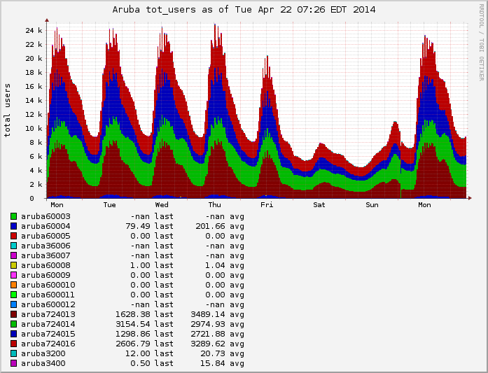
How many clients are on UDel’s Wifi?

Slide 18
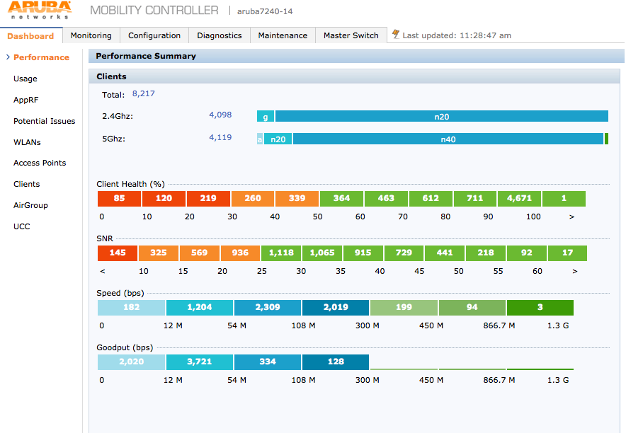
Client Distribution at UDel

Slide 19
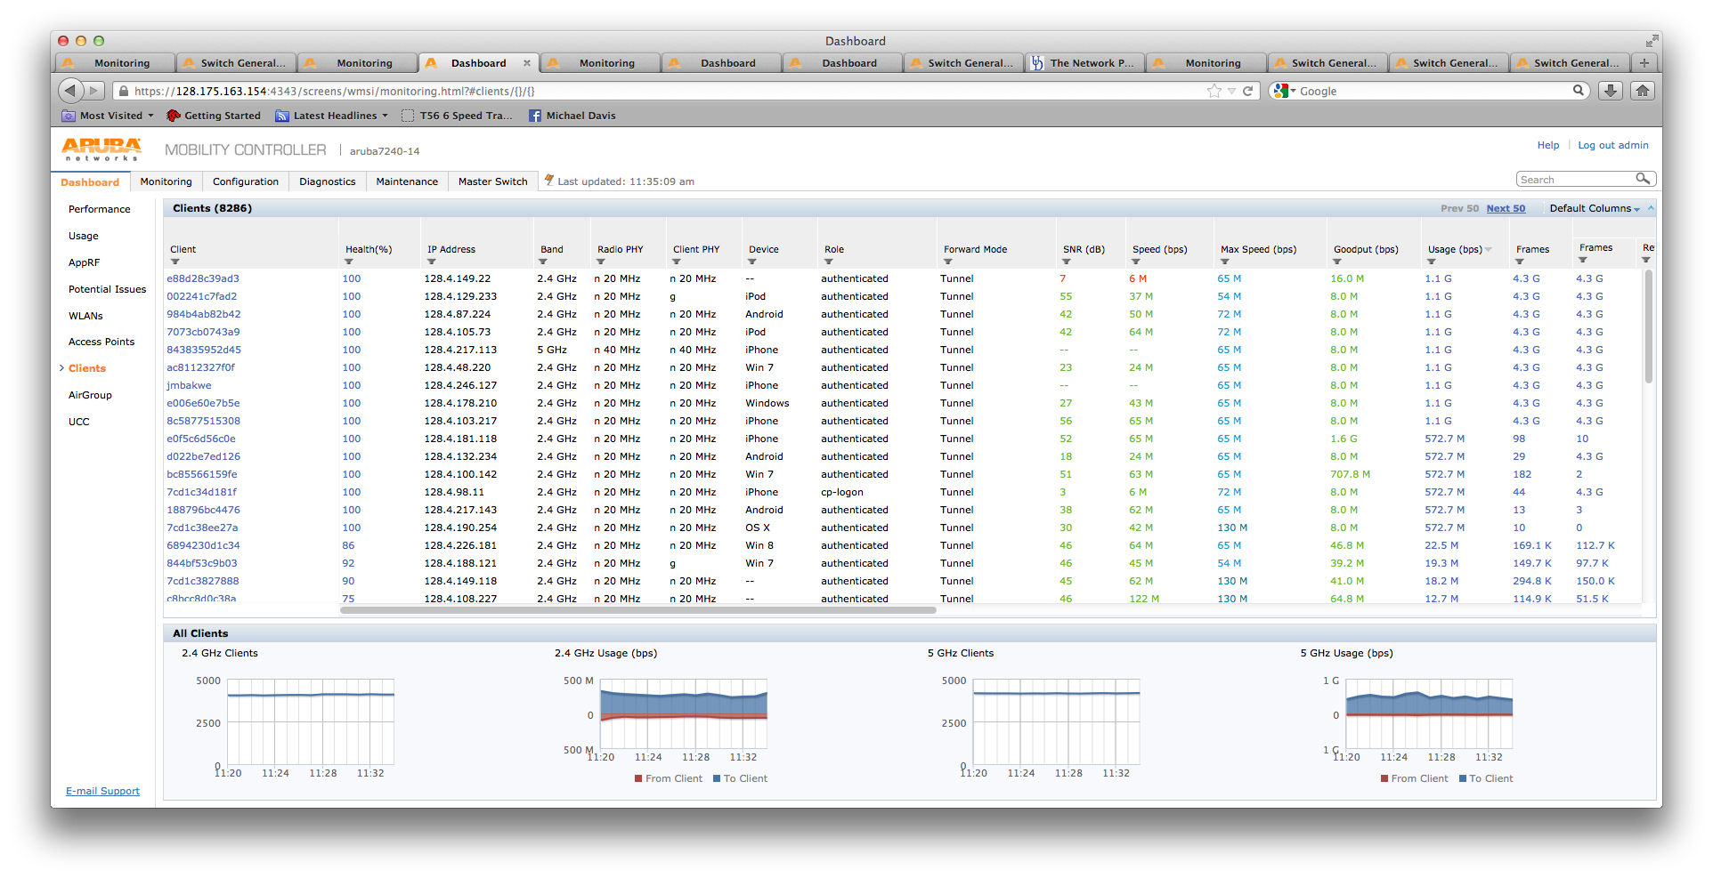
More Client Detail

Slide 20
Radio Interference
802.11b / 802.11g / 2.4GHz 802.11n
Operate at frequencies used by other devices
Are prone to interference from:
Bluetooth® devices, such as cellular phone headsets
Cordless phones
Microwave ovens
802.11a / 5GHz 802.11n/ 802.11ac
Operate at frequencies less occupied by other devices
802.11ad
Very good rate vs. range.
Extremely prone to attenuation (walls, people)

Slide 21
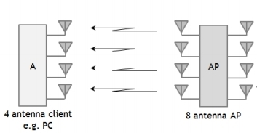
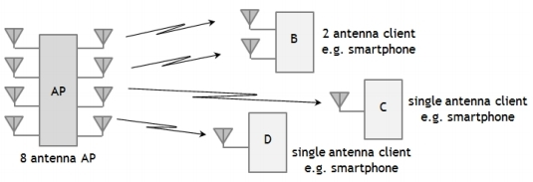
802.11n/ac Improvements
MIMO (multi-in, multi-out)
Uses multiple wireless signals and antennas to allow simultaneous transmission of multiple streams of data
MU-MIMO: Multi-user MIMO
Allows a single 802.11ac device to transmit independent data streams to multiple different stations at the same time.

Slide 22
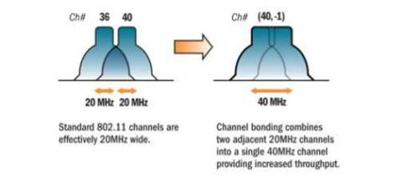
802.11n/ac Improvements
Channel Bonding
use of two separate nonoverlapping channels at same time to transmit data (20 MHz channel to 40 MHz channel). A no-no on 2.4GHz.

Slide 23
Channels Per Access Point
Adjacent access points should not use the same channel.
Difficult in 3-dimensional buildings with 802.11b or 802.11g, which only has 3 non-overlapping channels (channel 1, 6, 11).
http://www.wlanbook.com/wireless-network-performance-channel-planning/
Easier with 802.11a, 802.11n and 11ac which has up to (21) 20MHz channels (9 with 40 MHz channels, 4 80 MHz channels) non-overlapping channels.
If interference or error count is high, switch the wireless channel

Slide 24
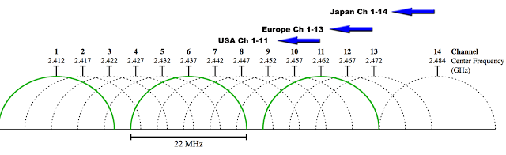
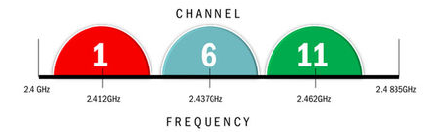
2.4 GHz Channel Visualization

Slide 25
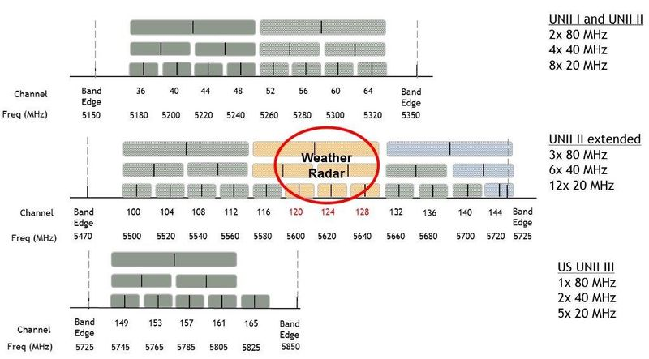
5GHz Channel Visualization

Slide 26
How are channels selected?
In large-scale wifi networks, admins can’t manually choose channels for the APs
Aruba controllers coordinate channel and power settings for all APs on campus
Channels will not be changed if clients are connected. Does not apply to Dynamic Frequency Selection (DFS) channels

Slide 27
Name | 11g-Clients | 11g-Ch/EIRP/MaxEIRP | 11a-Clients | 11a-Ch/EIRP/MaxEIRP
ap-nc10-318-1 | 0 | AP:HT:1/22/22 | 2 | AP:HT:153-/23/23
ap-ne67-151-2 | 0 | AP:HT:1/9/21 | 0 | AP:VHT:64E/21/22
ap-nn61-100-4 | 2 | AP:HT:6/15/22.5 | 0 | AP:HT:157+/24/24
ap-nn04-104-1 | 5 | AP:HT:11/22/22 | 0 | AP:HT:108+/22/22

Slide 28
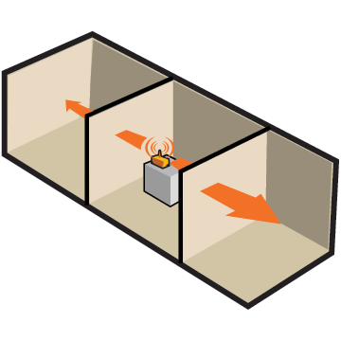
Wireless Router (AP) Placement
Place in a room in the middle of your house
Avoid wireless connections that go through more than two walls or two floors for video transmission
802.11n/ac routers perform better due to use of advanced signal processing and multiple antennas
Walls dramatically reduce the range of router

Slide 29
Demo
Let’s set up a WLAN!

